Slide 1
《Image processing visualization system》
Software development plan

Slide 2
目录
01 Project overview
02 Functional requirement
03 Development schedule

Slide 3
1.1 Project background
With the rapid development of artificial neural network, more and more people show their interest in computer image processing technology, but if they face stiff formulas and codes at the first contact, it may be very difficult for newcomers to get started. Moreover, it is difficult for most of the neural network models used for images to intuitively display the influence of various hyperparameters on the final results.
Therefore, we developed image processing visualization software. Image processing technology visualization software allows some commonly used image enhancement technology and simple image recognition neural network to be presented to users in a visual and interactive form.

Slide 4
1.2 Requirements overview
The corresponding requirements of Image Processing Visualization System are as follows:
1. Visualization of image enhancement method: OpenCV is used for gray level change, histogram correction, filtering and other processing. Users can upload images and agree to display the processed images on the interface. You can adjust the parameters to intuitively see the impact on image enhancement.
2. Visualization of convolutional network: As a classical technology of computer vision, visualization displays the results brought by the adjustment of parameters such as convolutional kernel size and step size.
3. Simple image recognition display: Provide a license plate recognition network model, users can upload pictures, experience the effect of image recognition.

Slide 5
1.3 Membership arrangement
Gong Zikang
Xi
Mingyuan
Xu
Kunhai
Xu
Yuzhuo
week1-3:Project manager
week4-10:Project manager
week11-12:Test engineer
Development task: Visual interface design
week4-6:Project manager
week2-9:Development engineer
Development task：Use opencv to complete the image enhancement related code
week7-9:Project manager
week4-10:Project manager
week11-12:Test engineer
Development task: Construct license plate recognition model and realize process visualization
week10-12:Project manager
week2-9:Development engineer
Development task: Complete the visualization design of convolution operation

Slide 6
2.1 Image enhancement visualization module
Image loading
Image smoothing
Image sharpening
Load the image from the file path given by the user
Users can click on the icon to smooth the image.
Users can adjust the sharpening ratio by dragging the progress bar.
Brightness adjustment
Histogram correction
Filter processing
The user can adjust the contrast ratio of the image by dragging the progress bar.
Histogram equalization method is used to make the image gray distribution uniform and the image details clear.
The median filtering algorithm is used to eliminate the isolated noise points in the image.

Slide 7
2.2 Image geometry transformation module
Image translation
Image scaling
Horizontal and vertical mirror images
Users can set the translation height and width.
Users can customize the scale.
Users can interact by clicking the icon and mirror the picture vertically and horizontally.
Image transpose
Image clipping
Image rotation
Users can interact by clicking on the icon to transpose the image.
The user can set the clipping ratio through the dialog box and crop the picture accordingly.
The user can set the rotation Angle through the dialog box.

Slide 8
2.3 Convolutional Network visualization module
& Image recognition display module
Parameter adjustment
Convolutional neural network visualization
Image recognition function
1) Users can adjust parameters such as the number, size and step size of convolutional nuclei in the convolutional neural network through the dialog box.
2) Adjust parameters in the convolutional neural network according to parameters provided by users.
1) Visualize the results of convolutional neural networks and display them in specific Windows.
2) Users can save the results.
1) Image recognition is realized through convolutional neural network.
2) Display the result in a specific window and compare it with the original picture.

Slide 9
3.1 Development schedule
Analyze product requirements,
Write software requirements specification
Write a small test demo on the IDE、
Configure the development environment
Complete image translation
function interfaces
WEEK 1
WEEK 2
WEEK 3
WEEK 4-5
WEEK 6
Learn the basic usage of
git/pyqt/opencv
The theoretical learning stage ends,
and it is time to start coding.
Build the PyQt visual window framework,
determine UI layout, display area,
and button functions.

Slide 10
3.1 Development schedule
Complete the convolution operation
demonstration function
Integrate various functional
modules and PyQt interface.
WEEK 7-8
WEEK 9-10
WEEK 11
WEEK 12
Project testing and acceptance、
write software usage instructions
and project summary report.
Complete image detection neural network
decomposition and demonstration functions.

Slide 11
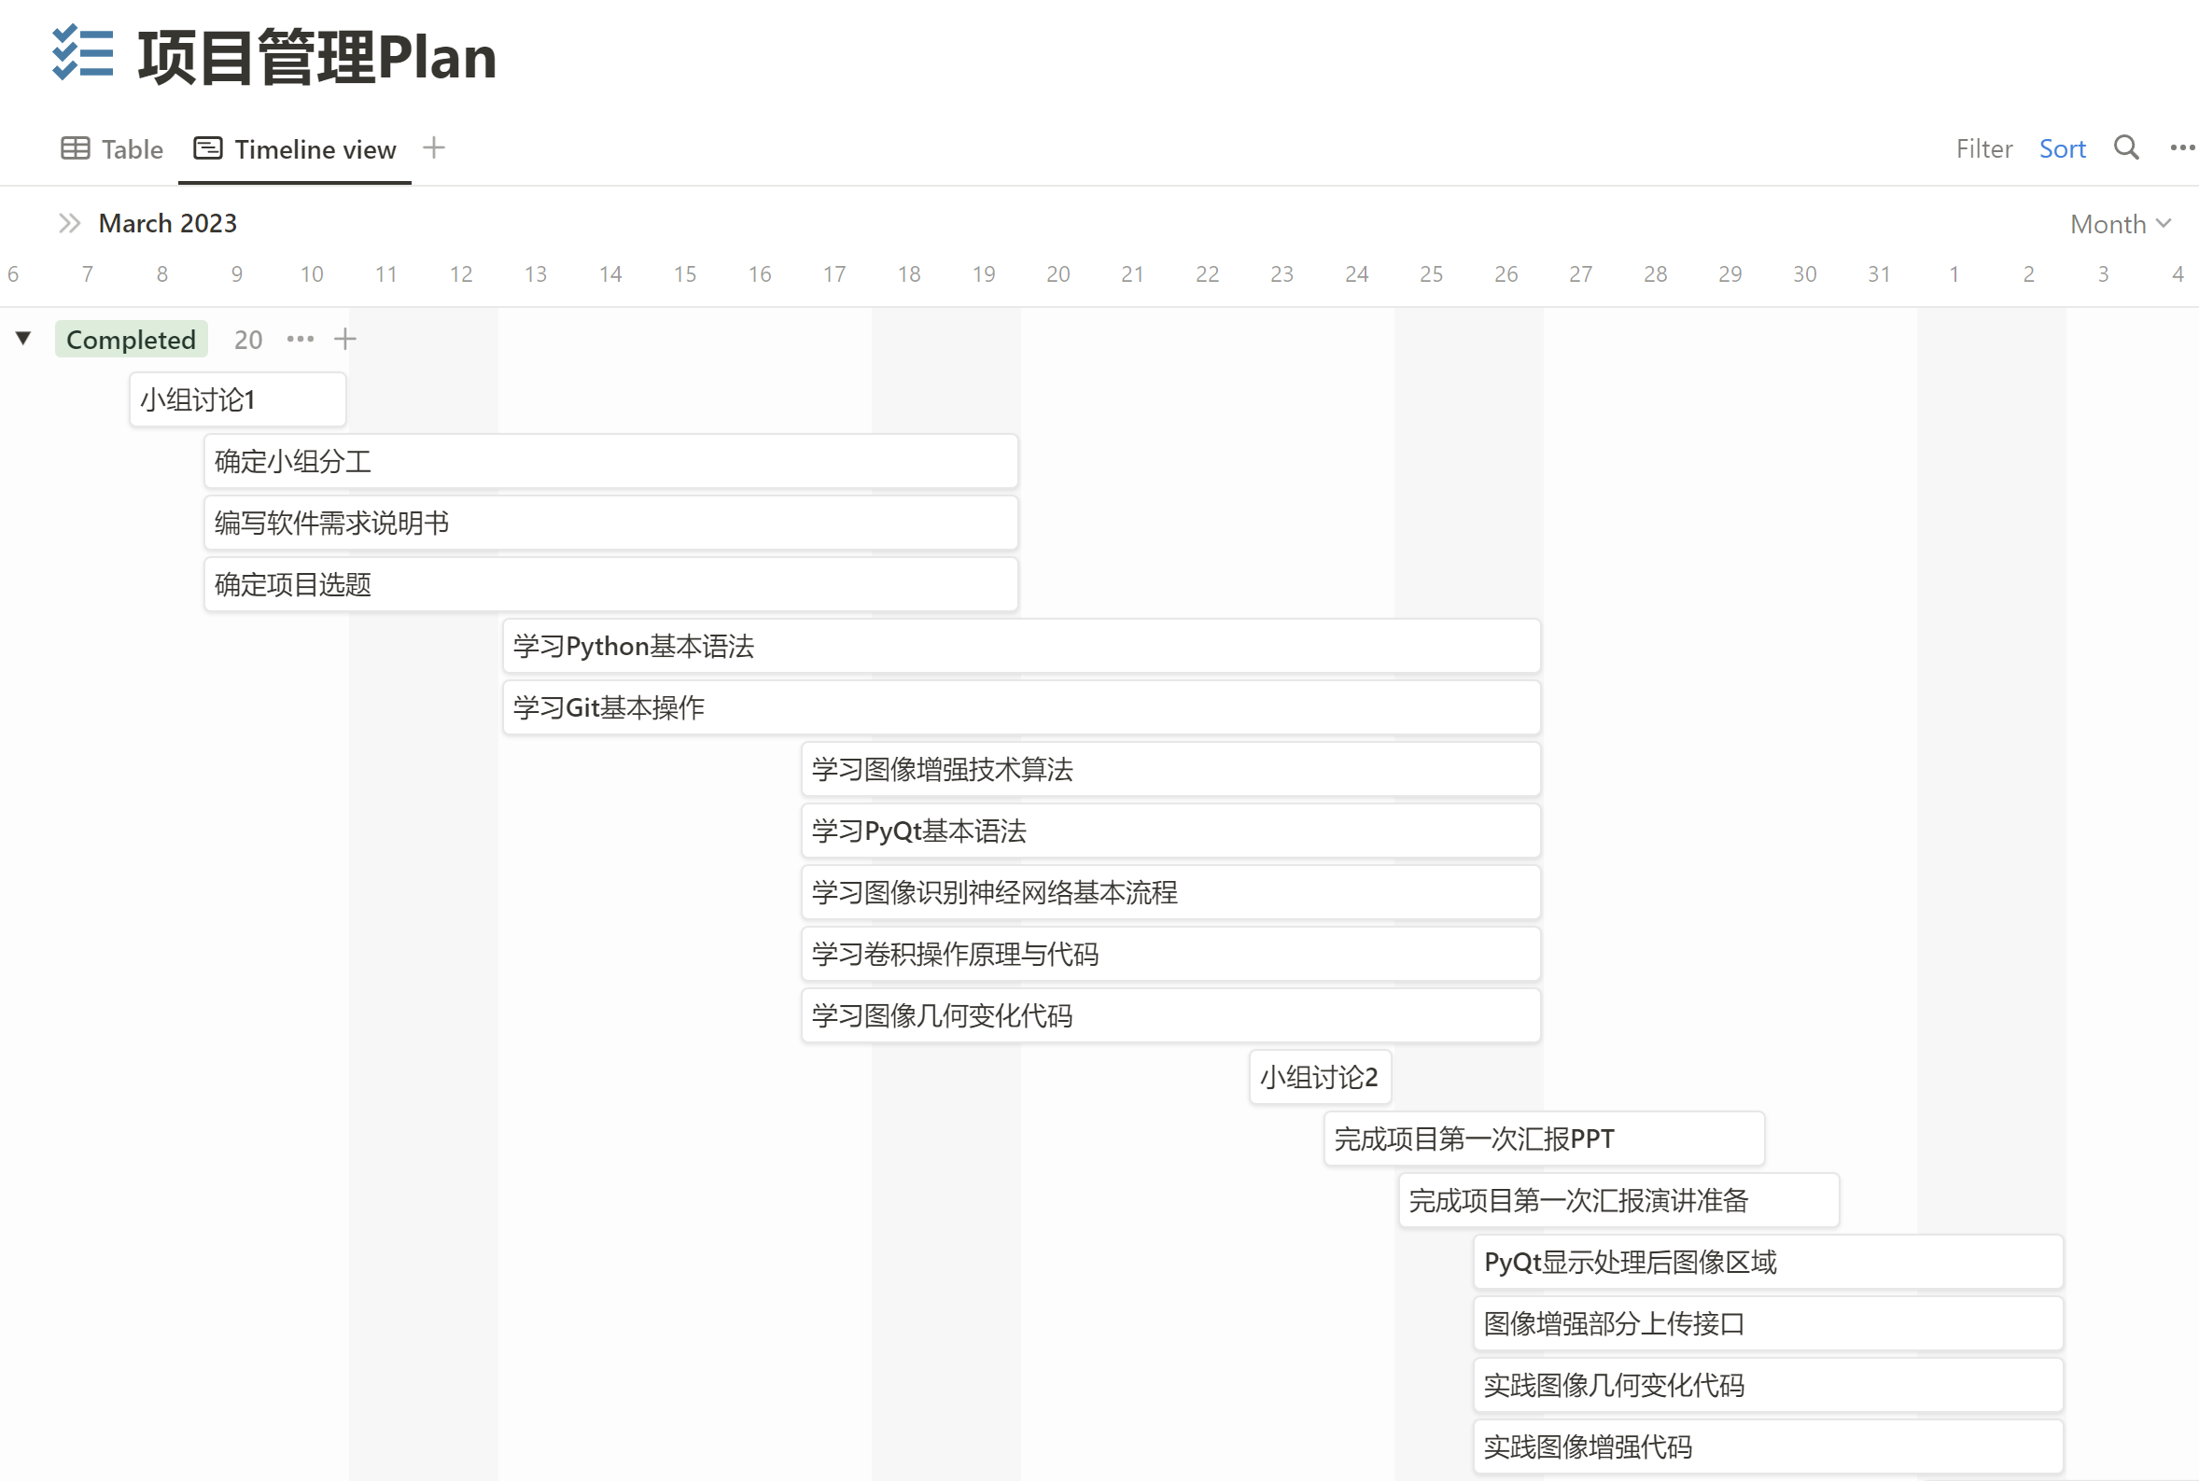
3.2 Development timeline

Slide 12
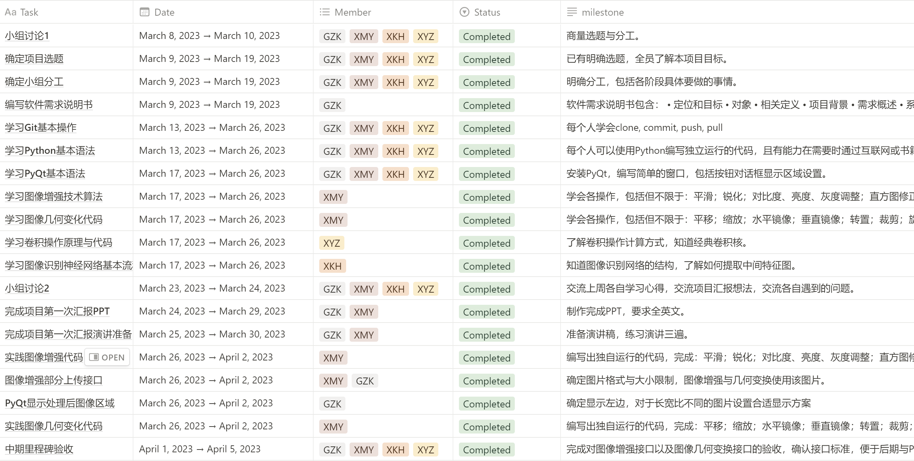
3.3 Tasks and milestones

